Slide 1
Lecture 19
Java Generics

Slide 2
Lecture Objectives
To understand the objective of generic programming
To be able to implement generic classes and methods
To know the limitations of generic programming in Java
To understand the relationship between generic types and inheritance

Slide 3

The Problem

Slide 4
The Problem
We want to implement ADT such as a Stack for many different types, such as Integer, Double, String or other self defined object.
We want to implement algorithm for different types, such as merge/sort for Integer, Double, String or any comparable user defined object.
Notes:
We want to implement ADT such as a Stack for many different types, such as Integer, Double, String or other self defined object.
We want to implement algorithm for different types, such as merge/sort for Integer, Double, String or any comparable user defined object.
With our current knowledge, we must either
create a class (ADT)/method(Algorithm) for each type (see code IStackInteger, ArrayStackInteger, IStackString, ArrayStackString)
Create a class/method for the type Object and then cast the element into the desired type (see code IStackObject, ArrayStackObject)
The latter leads to unsafe type checking, that is the compiler cannot enforce type checking on this class or method (see main method from ArrayStackInteger and ArrayStackObject)

Slide 5
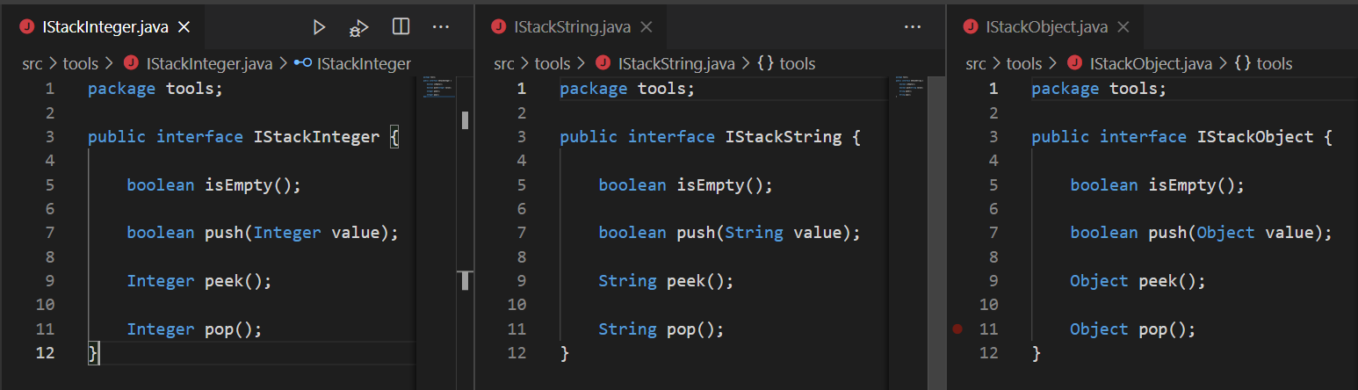
The Problem

Slide 6
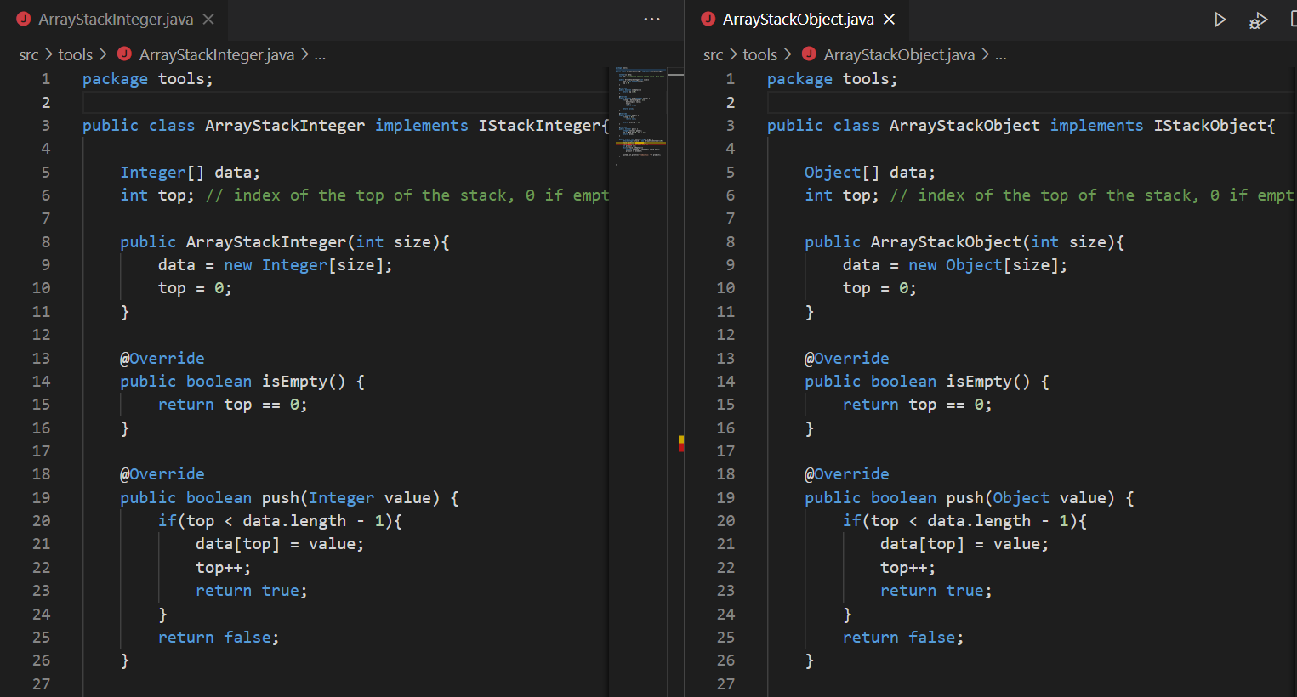
The Problem

Slide 7
The problem
Unsafe type casting
ArrayStackInteger.main(String[])
ArrayStackObject.main(String[])
IStackInteger stack = new ArrayStackInteger(10);
stack.push(new Integer(1));
stack.push(new String("one")); //Compile error
int product = 1;
while(!stack.isEmpty()){
Integer element = (Integer) stack.pop();
product *= element;
}
System.out.println("product is: " + product);
ArrayStackObject stack = new ArrayStackObject (10);
stack.push(new Integer(1));
stack.push(new String("one"));
int product = 1;
while(!stack.isEmpty()){
Integer element = (Integer) stack.pop();
product *= element;
}
System.out.println("product is: " + product);
Runtime error

Slide 8
Java Generics

Slide 9
Parameterized Classes and Generics
The class ArrayList is a parameterized class
It has a parameter, denoted by Base_Type, that can be replaced by any reference type to obtain a class for ArrayLists with the specified base type
Starting with version 5.0, Java allows class definitions with parameters for types
These classes that have type parameters are called parameterized class or generic definitions, or, simply, generics

Slide 10
Parameterized Classes and Generics
A class/interface definition with a type parameter is stored in a file and compiled just like any other class.
Once a parameterized class/interface is compiled, it can be used like any other class.
However, the class type plugged in for the type parameter must be specified before it can be used in a program.
Doing this is said to instantiate the generic class.
ArrayList<String> object = new ArrayList <String>();

Slide 11
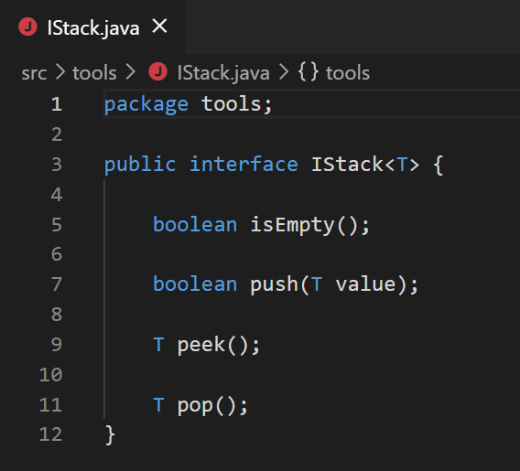
An Interface Definition with a Type Parameter
T is a parameter for a Type
Notes:
A class/interface that is defined with a parameter for a type is called a generic class or a parameterized class/interface
→
The type parameter is included in angular brackets after the class name in the class definition heading.
Any non-keyword identifier can be used for the type parameter, but by convention, the parameter starts with an uppercase letter.
The most commonly used type parameter names are:
E - Element (used extensively by the Java Collections Framework)
K - Key
N - Number
T - Type
V - Value
S,U,V etc. - 2nd, 3rd, 4th types
The type parameter can be used like other types used in the definition of a class.

Slide 12
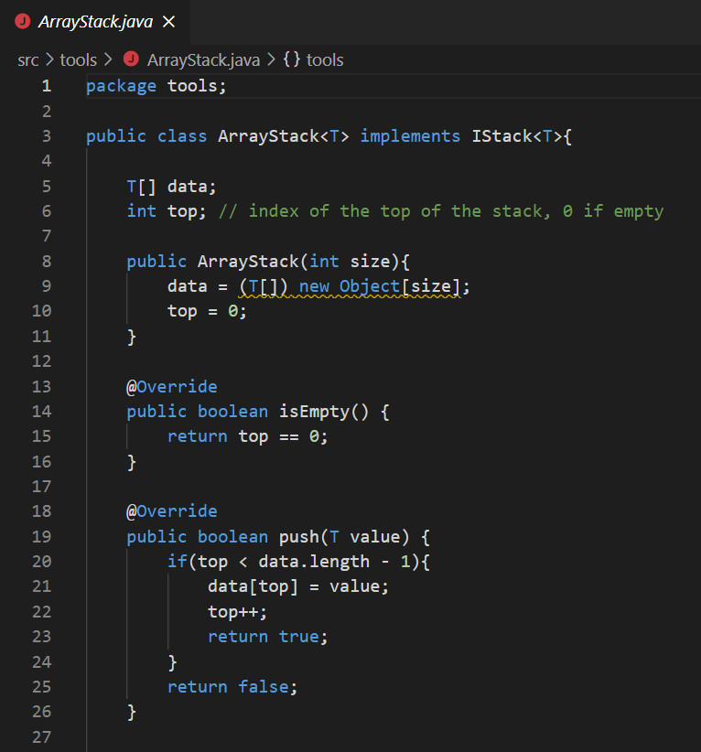
A Class Definition with a Type Parameter
T is a parameter for a Type
Constructor headings do not include <T>

Slide 13
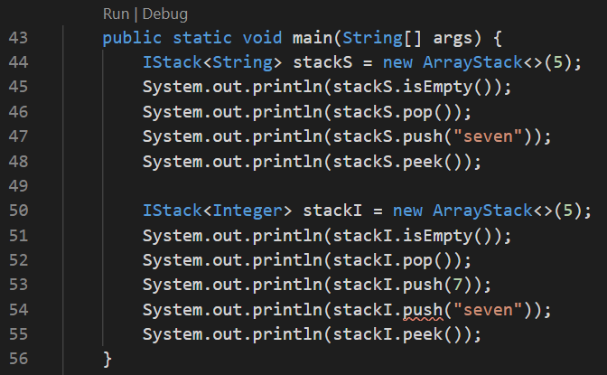
A Class Definition with a Type Parameter
Instantiate the parameter T
Compile Error, cannot push a String into a stack of Integer

Slide 14
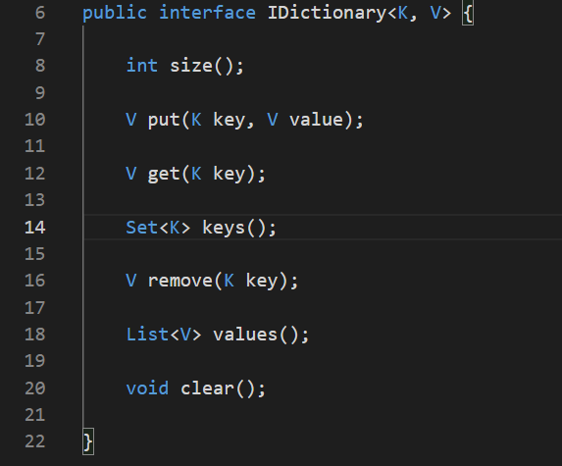
Multiple Type Parameters
A generic class definition can have any number of type parameters.
Multiple type parameters are listed in angular brackets separated by commas.

Slide 15
Bounds for Type Parameters
Sometimes it makes sense to restrict the possible types that can be plugged in for a type parameter T.
For instance, to ensure that only classes that implement the Comparable interface are plugged in for T, define a class as follows:
public class RClass<T extends Comparable>
"extends Comparable" serves as a bound on the type parameter T.
Any attempt to plug in a type for T which does not implement the Comparable interface will result in a compiler error message.

Slide 16
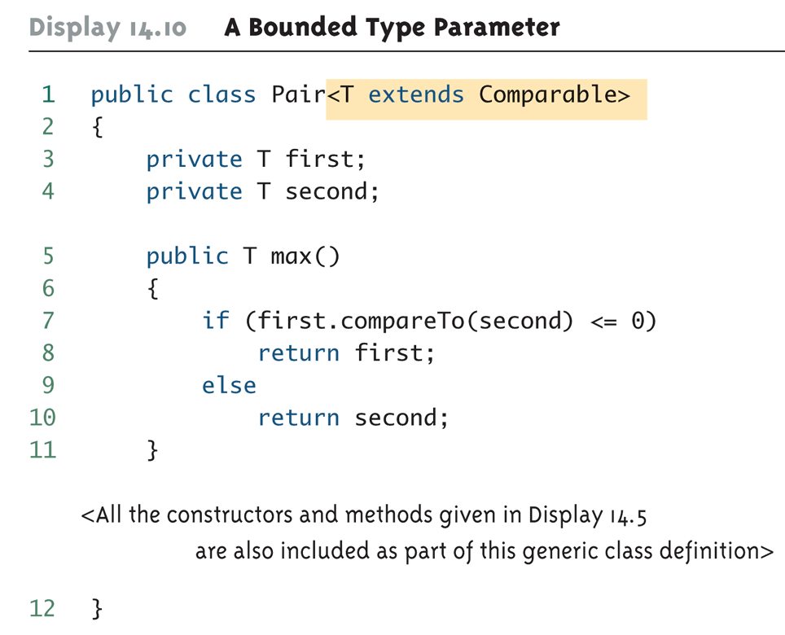
Bounds for Type Parameters

Slide 17
Bounds for Type Parameters
A bound on a type may be a class name (rather than an interface name)
Then only descendent classes of the bounding class may be plugged in for the type parameters:
public class ExClass<T extends Class1>
A bounds expression may contain multiple interfaces and up to one class.
If there is more than one type parameter, the syntax is as follows:
public class Two<T1 extends Class1,
T2 extends Class2 &
InterfaceA &
InterfaceB>

Slide 18
Limitations on Type Parameter Usage
Within the definition of a parameterized class definition, there are places where an ordinary class name would be allowed, but a type parameter is not allowed.
In particular, the type parameter cannot be used in simple expressions using new to create a new object
For instance, the type parameter cannot be used as a constructor name or like a constructor:
T object = new T(); //Compile error
T[] a = new T[10]; //Compile error

Slide 19
Limitations on Generic Class Instantiation
Arrays such as the following are illegal:
Pair<String>[] a =
new Pair<String>[10];
Although this is a reasonable thing to want to do, it is not allowed given the way that Java implements generic classes

Slide 20
Restrictions on Generics
To use Java generics effectively, you must consider the following restrictions:
Cannot Instantiate Generic Types with Primitive Types
Cannot Create Instances of Type Parameters
Cannot Declare Static Fields Whose Types are Type Parameters
Cannot Use Casts or instanceof With Parameterized Types
Cannot Create Arrays of Parameterized Types
Cannot Create, Catch, or Throw Objects of Parameterized Types
Cannot Overload a Method Where the Formal Parameter Types of Each Overload Erase to the Same Raw Type

